Slide 1
TypeScript

Slide 2
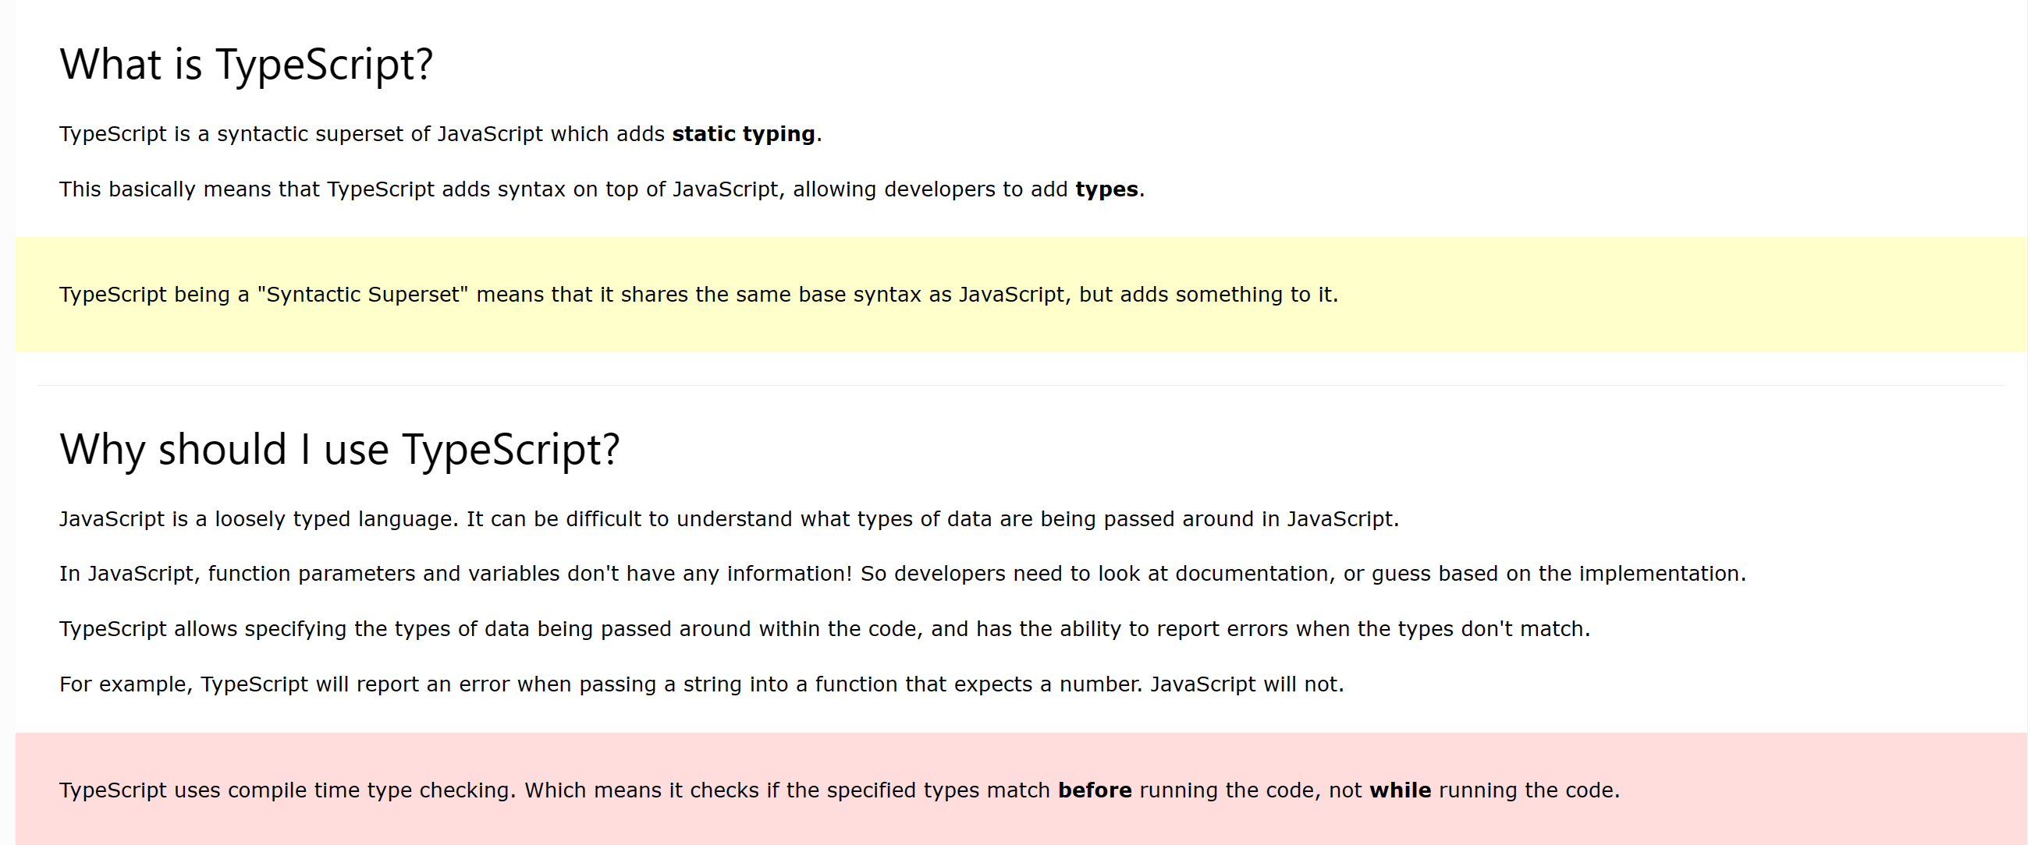
TypeScript is JavaScript with added syntax for types.

Slide 3
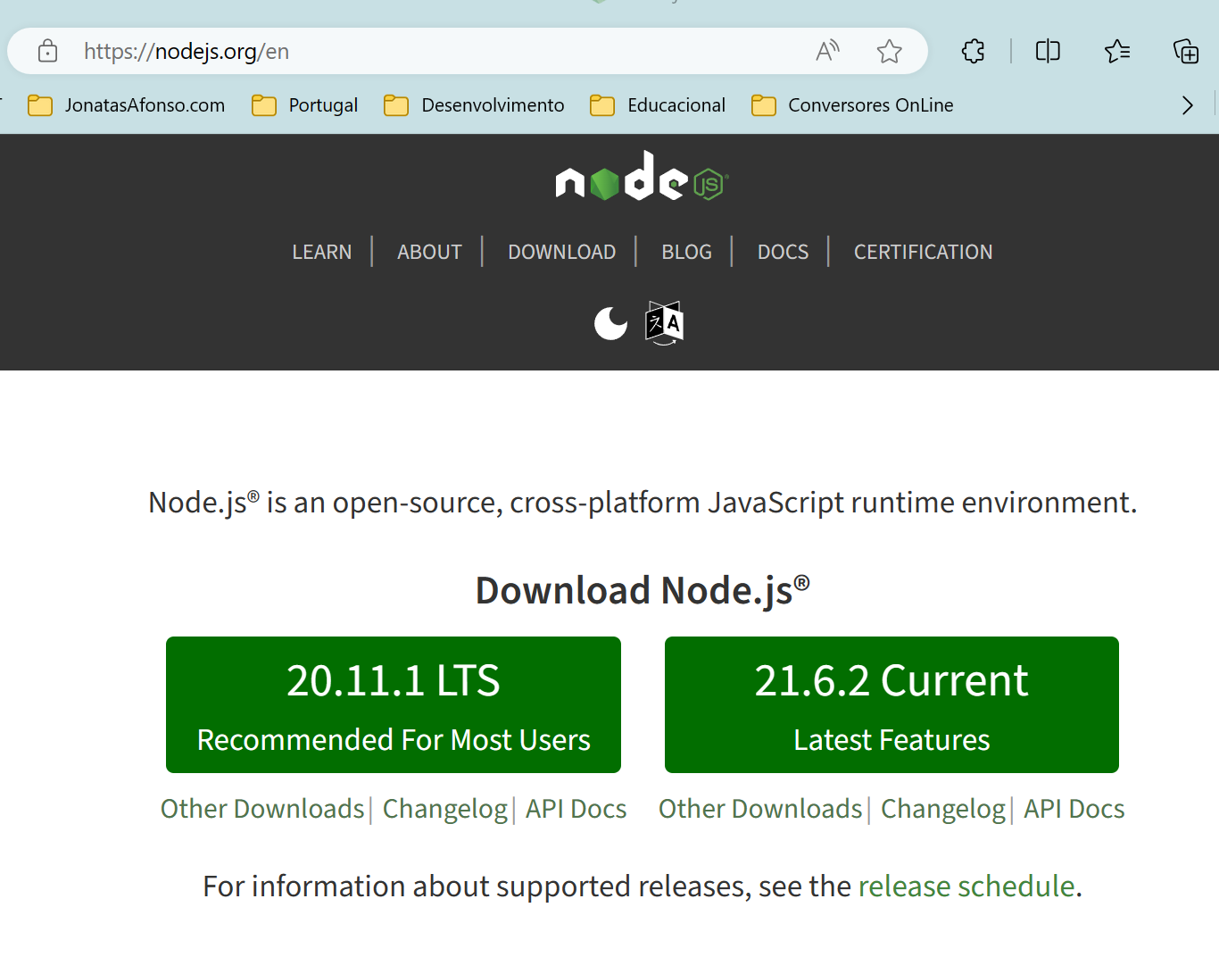
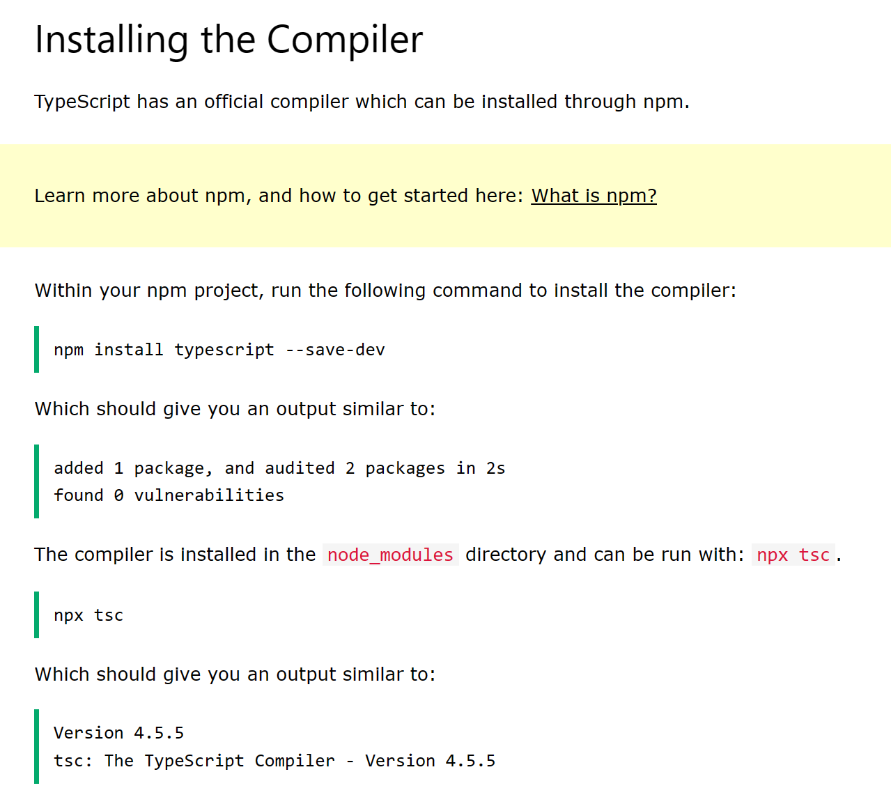
Instaling the Compiler.

Slide 4
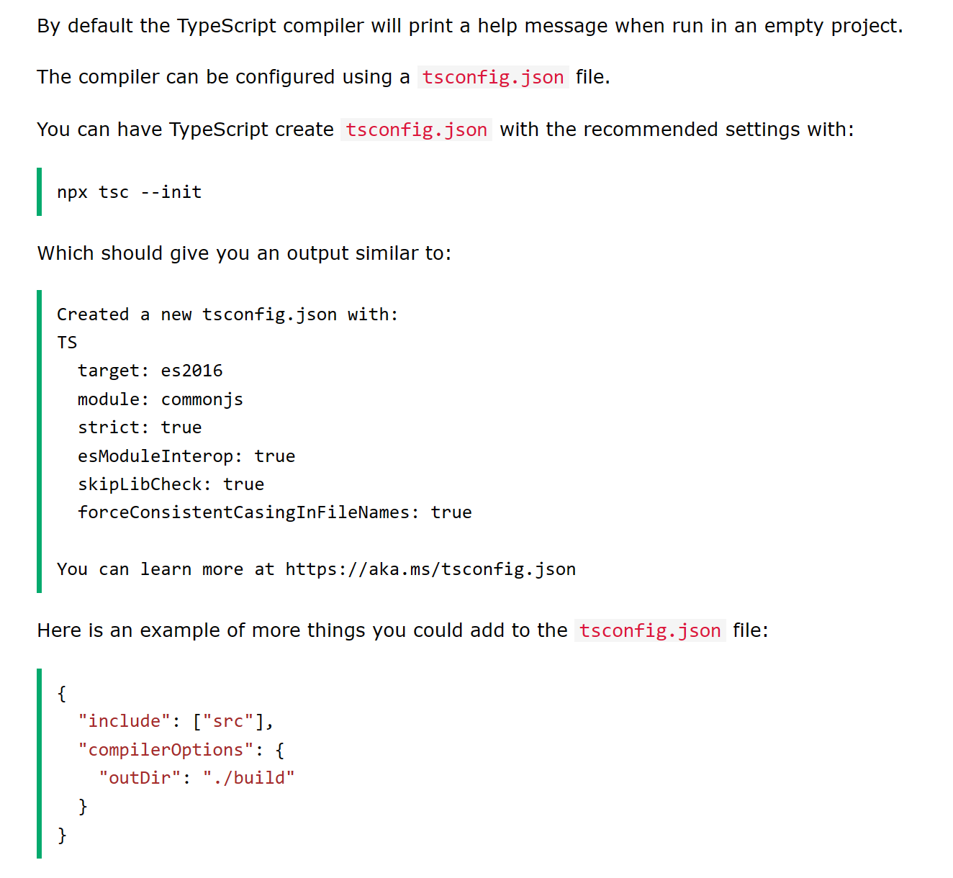
Configuring the Compiler.

Slide 5
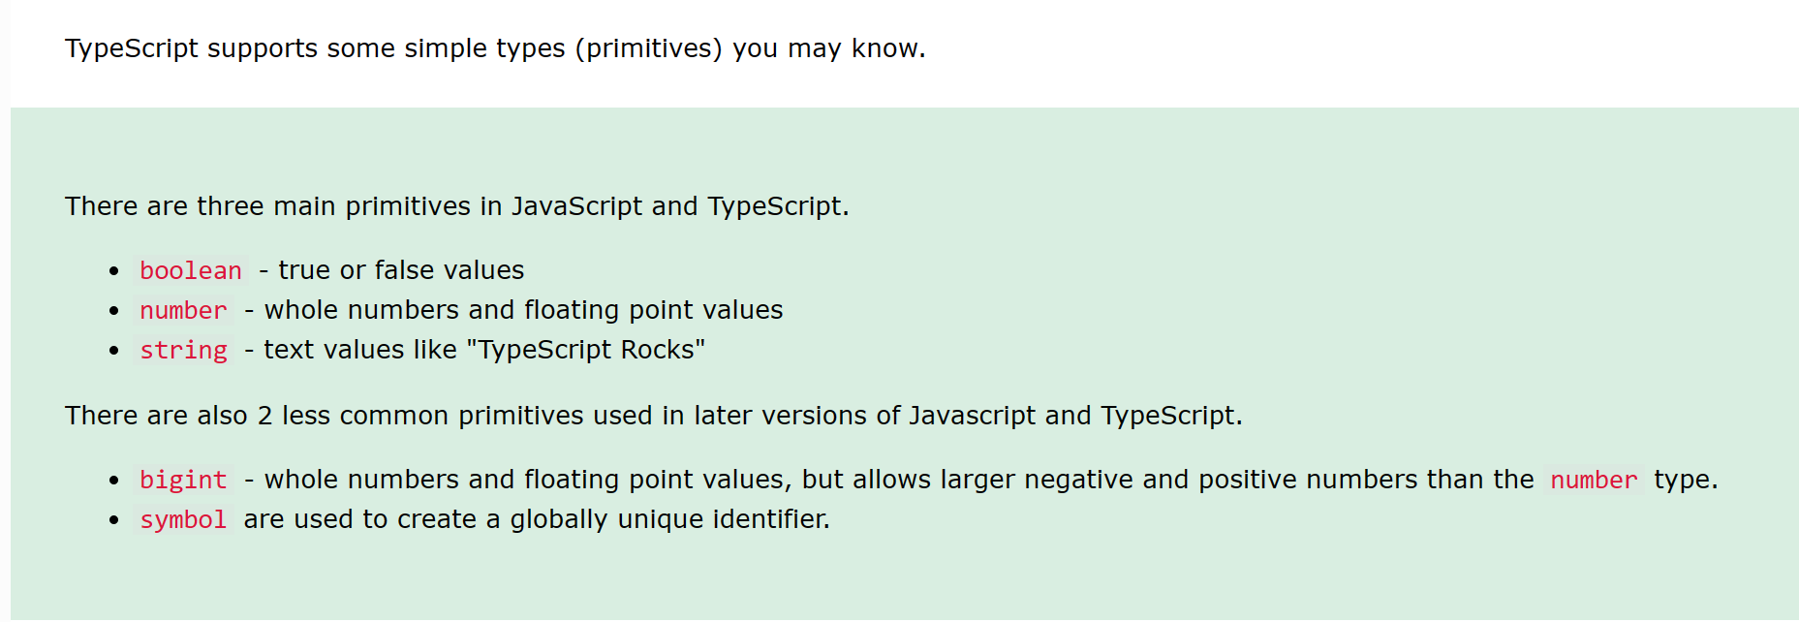
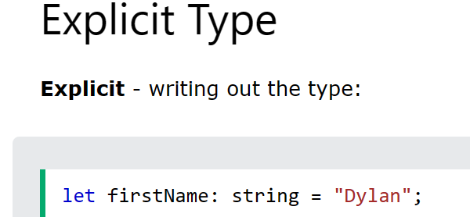
TypeScript simple types.

Slide 6
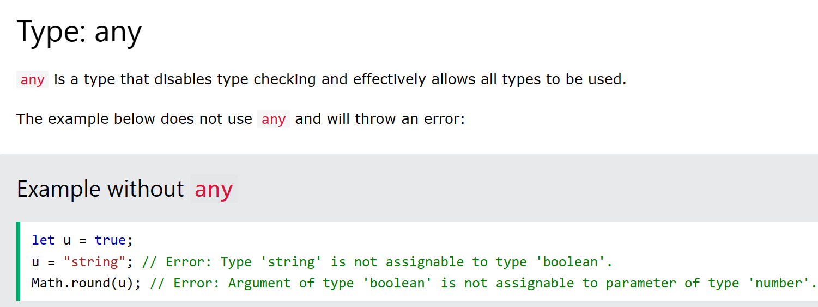
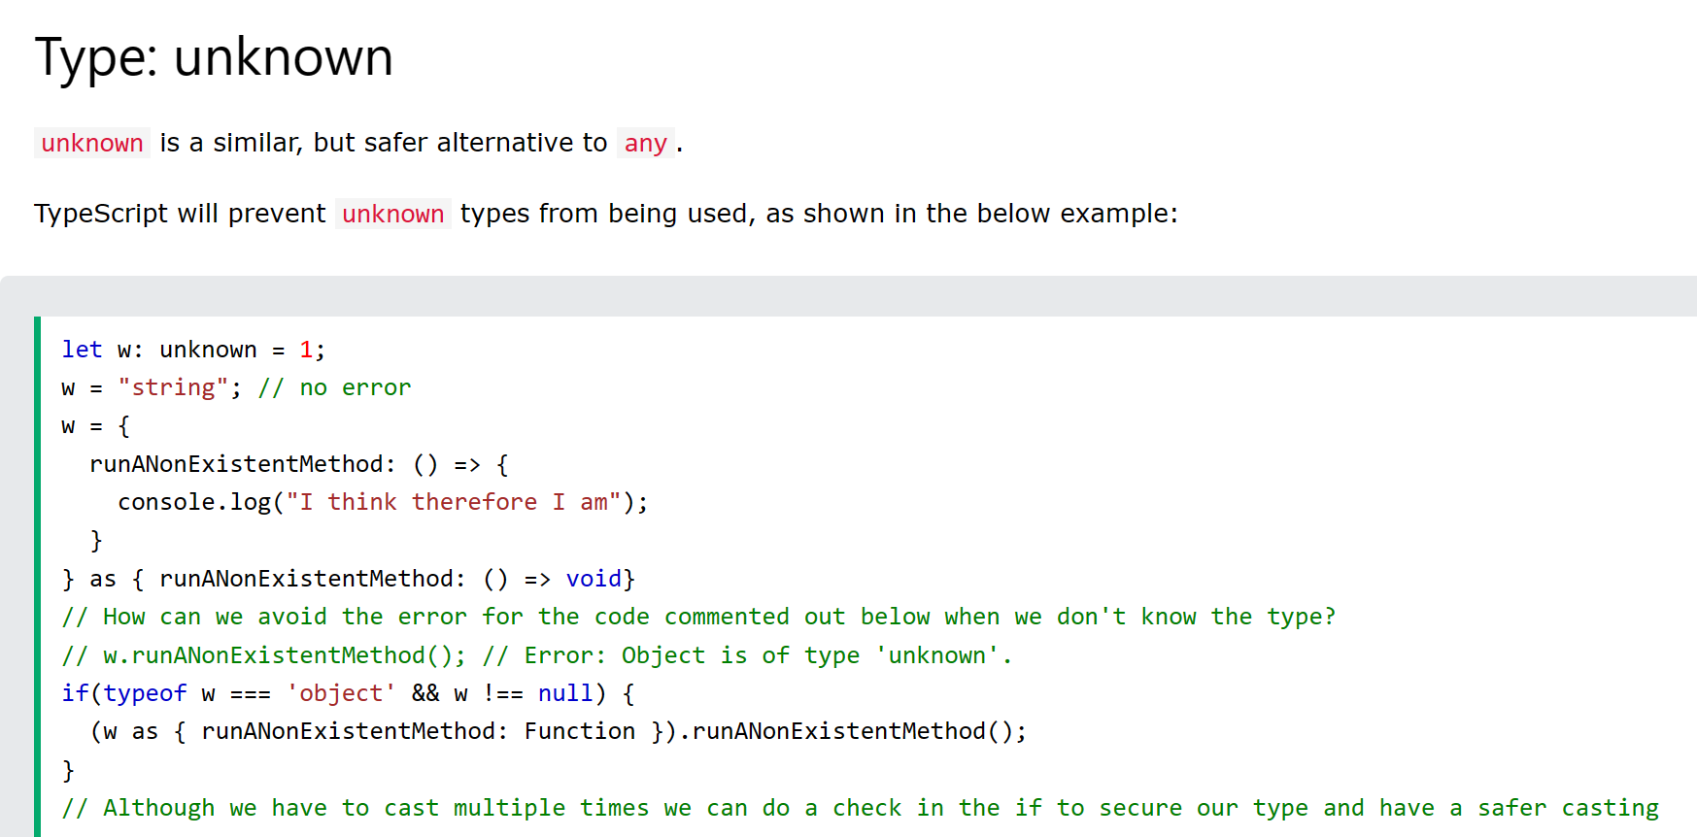
TypeScript Special Types.

Slide 7
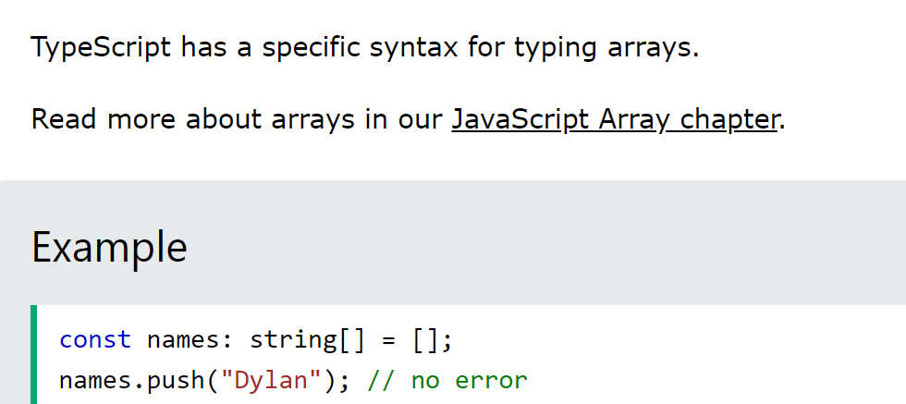
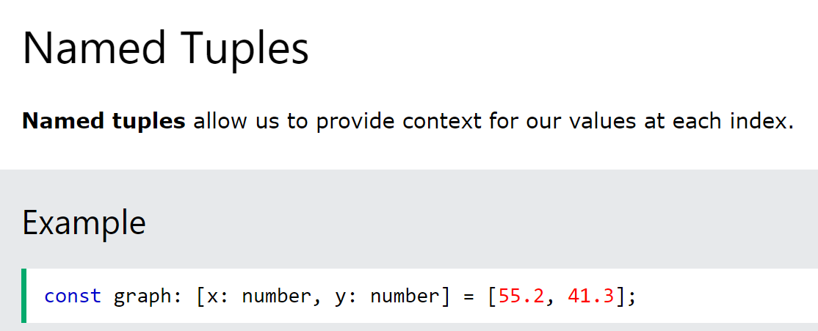
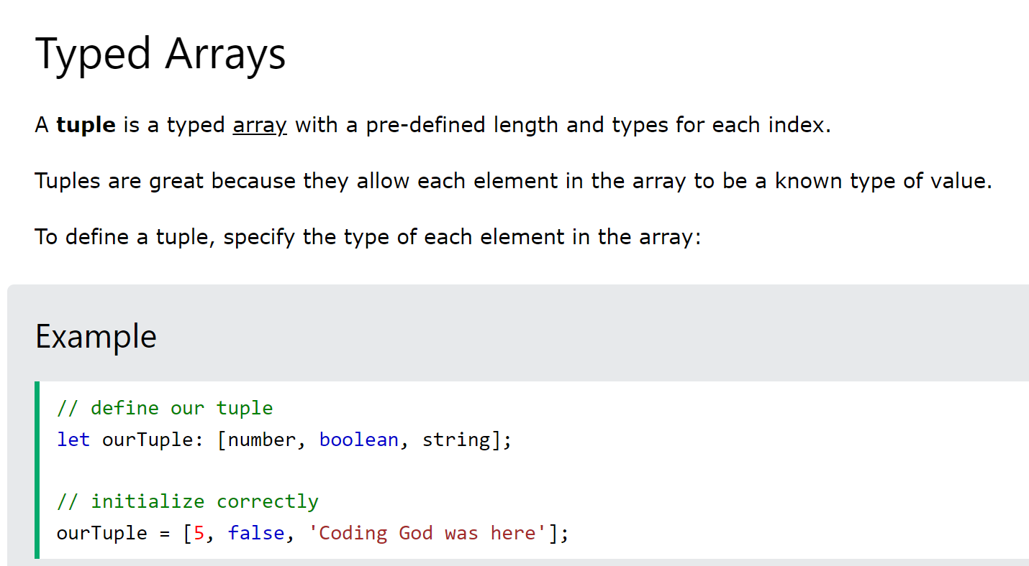
TypeScript Special Types.

Slide 8
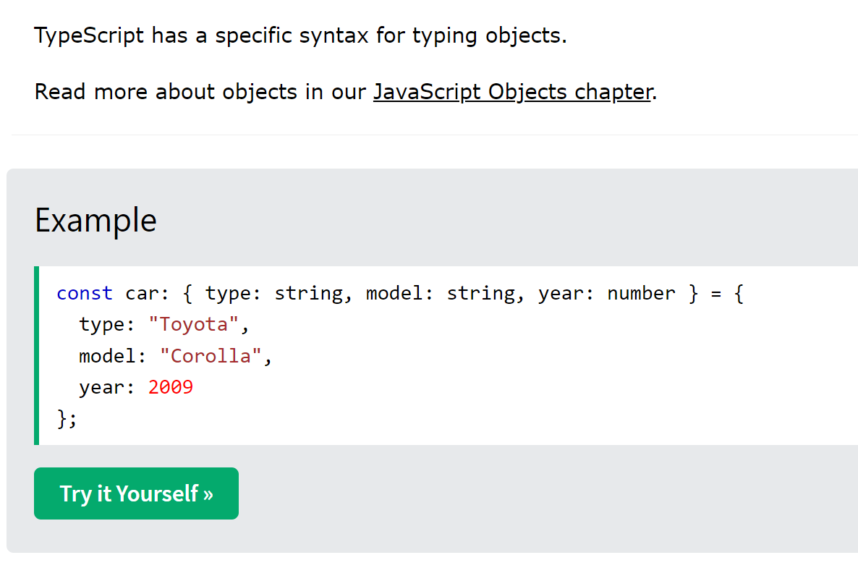
TypeScript Object Types.

Slide 9
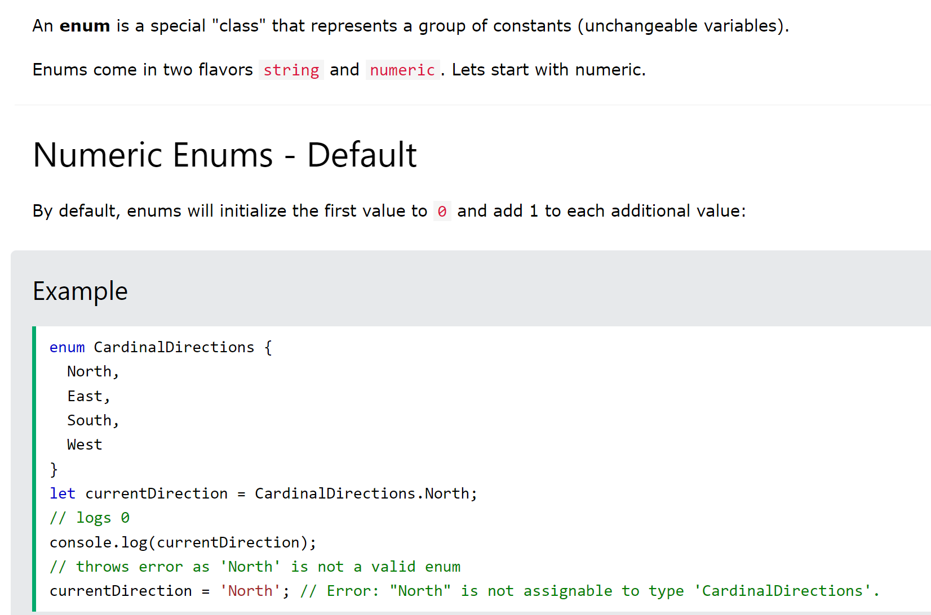
TypeScript Enums.

Slide 10
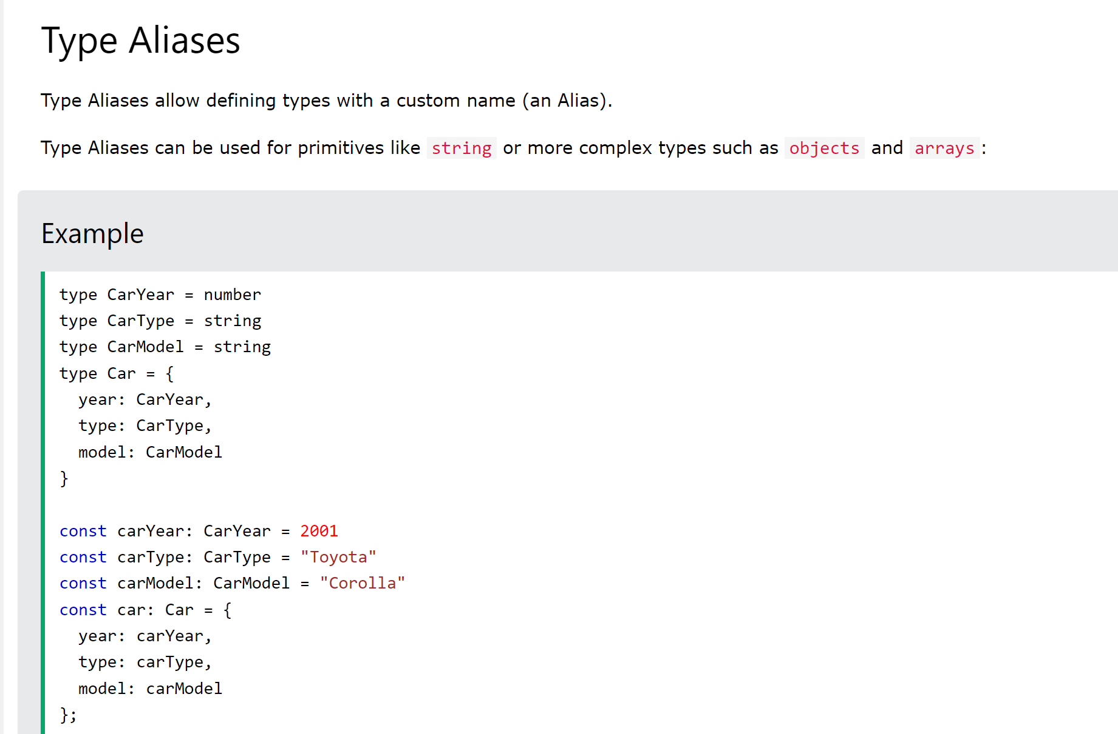
TypeScript Aliases.

Slide 11
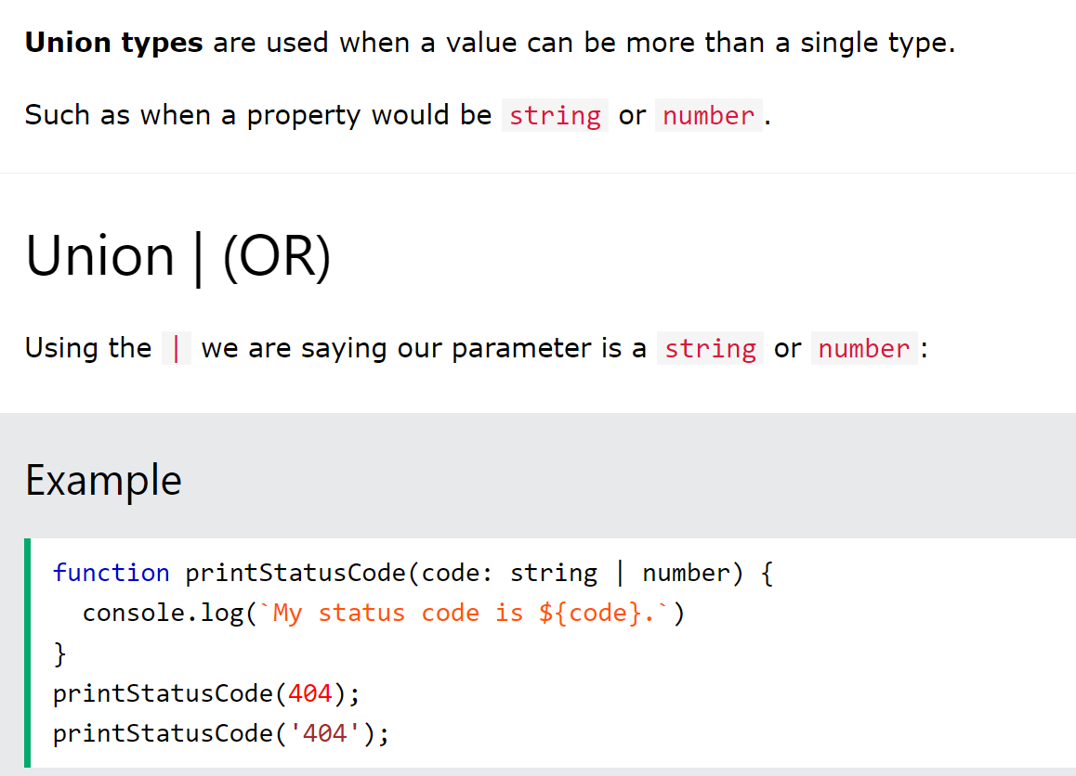
TypeScript Union Types.

Slide 12
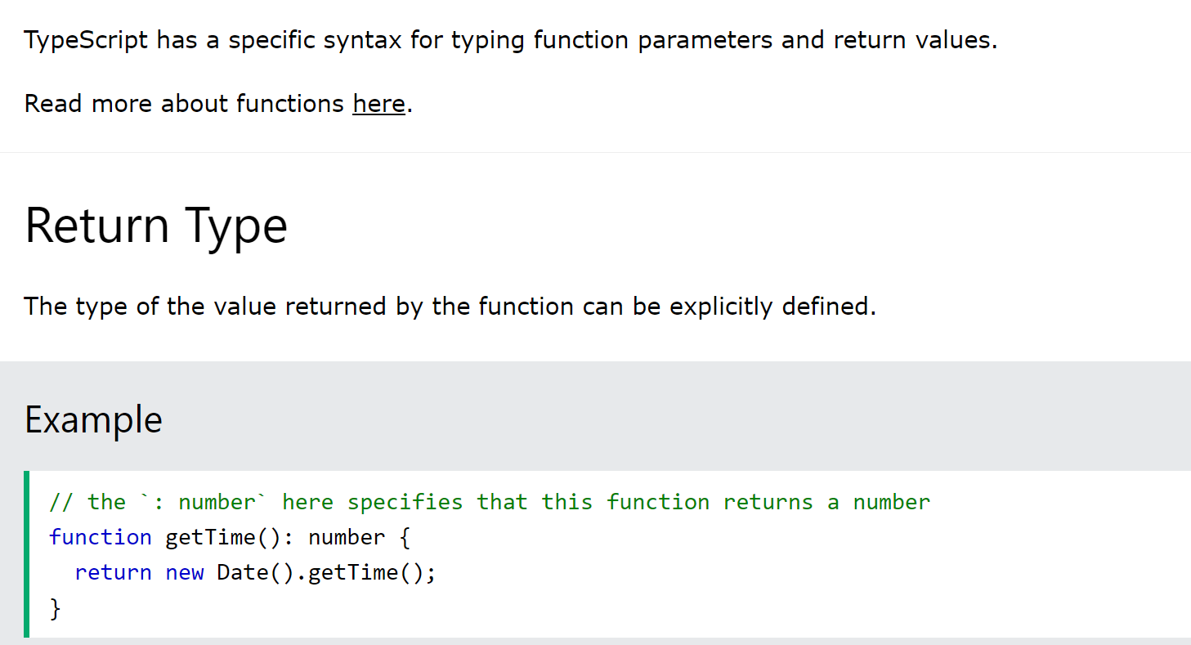
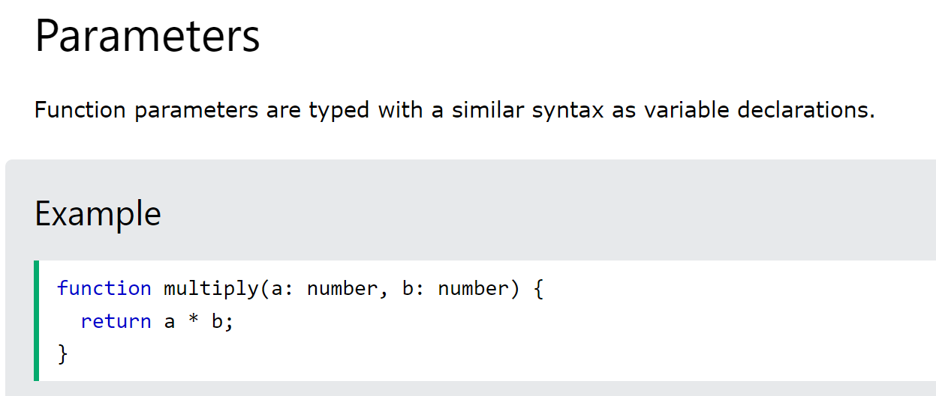
TypeScript Functions.

Slide 13
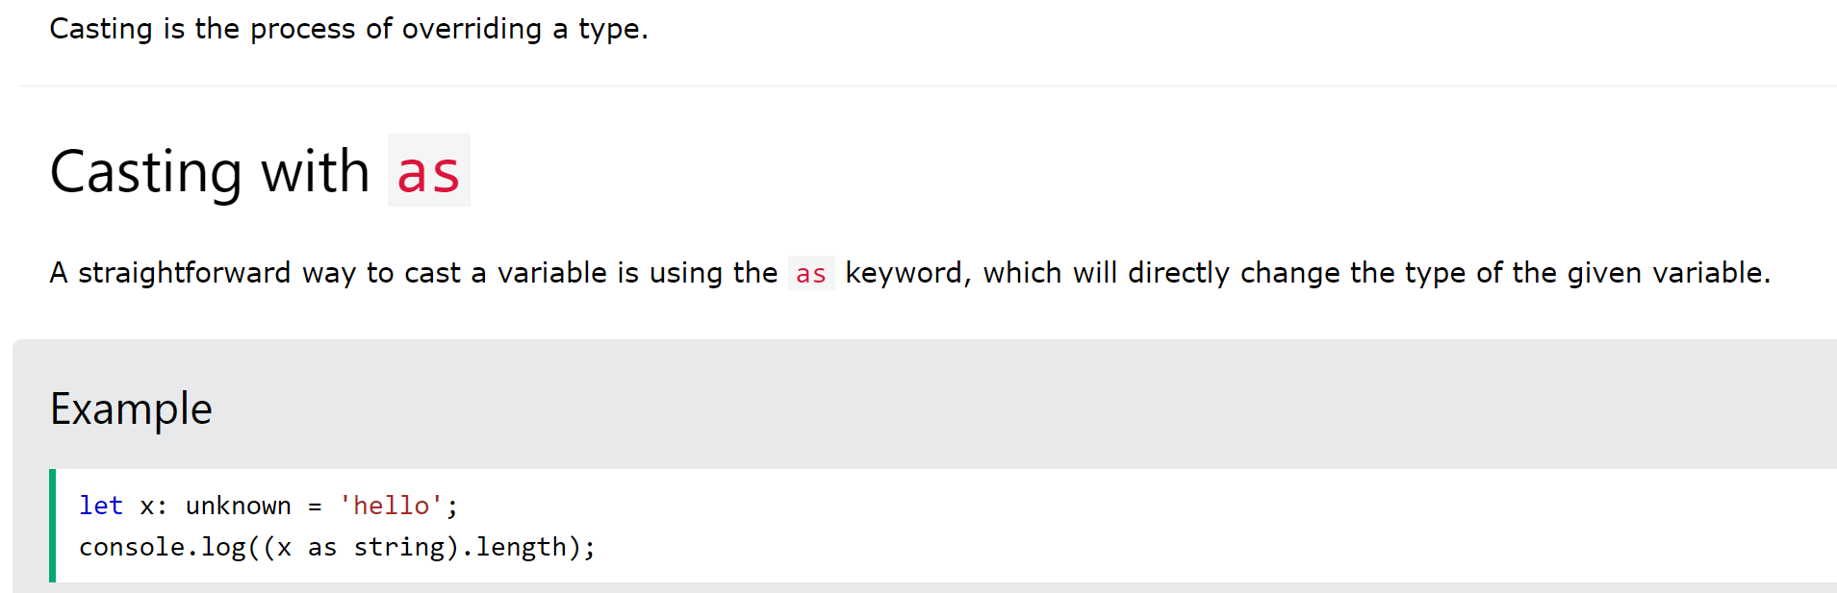
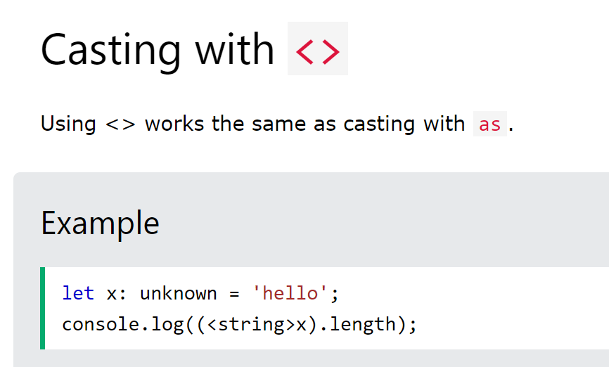
TypeScript Casting.

Slide 14
TypeScript Special Types.

Slide 15
TypeScript Special Types.

Slide 16
TypeScript Special Types.

Slide 17
TypeScript Special Types.

Slide 18
TypeScript Special Types.

